Slide 1


Airborne Radio Collar Tracker
Daniel Knapp
Thomas An
Naveen Ketagoda
Sam Vineyard

Slide 2
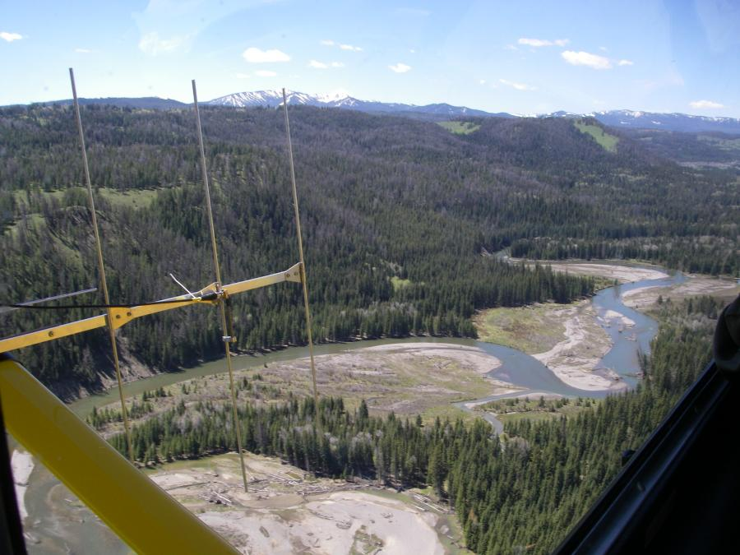
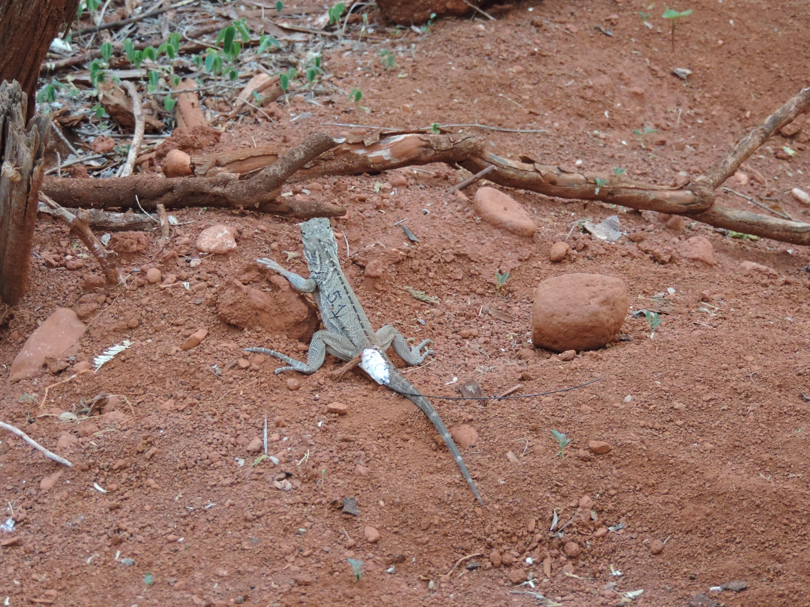
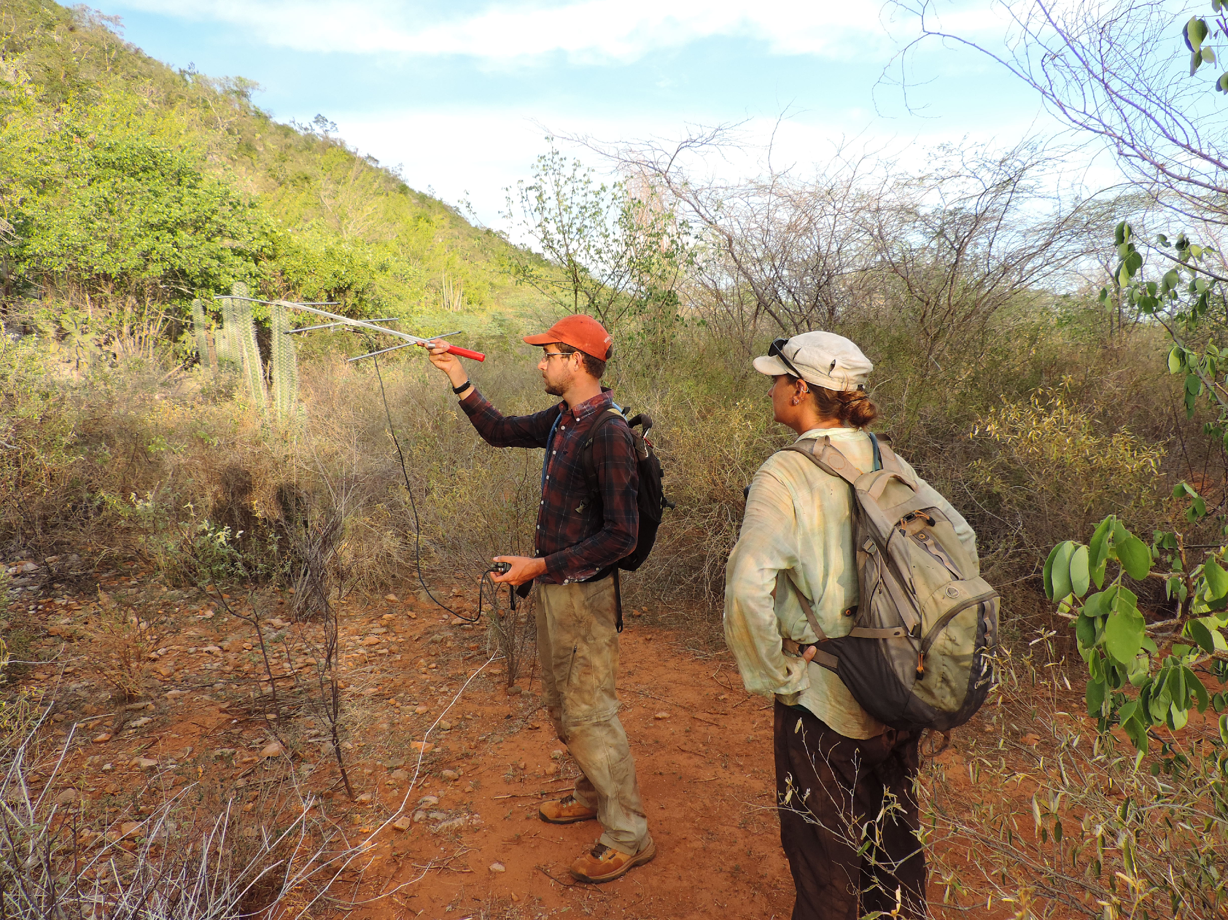
Project Motivation
Tracking wildlife radio collars is the most effective way of monitoring animal movement patterns
Environment can be difficult to traverse through and manual tracking can be time consuming
Figure 1: Airborne Radio Telemetry
Figure 2: Iguana with Radio Collar
Figure 3: Terrestrial Radio Telemetry
Notes:
Sam: most of the class already knows about this, we can keep this brief

Slide 3
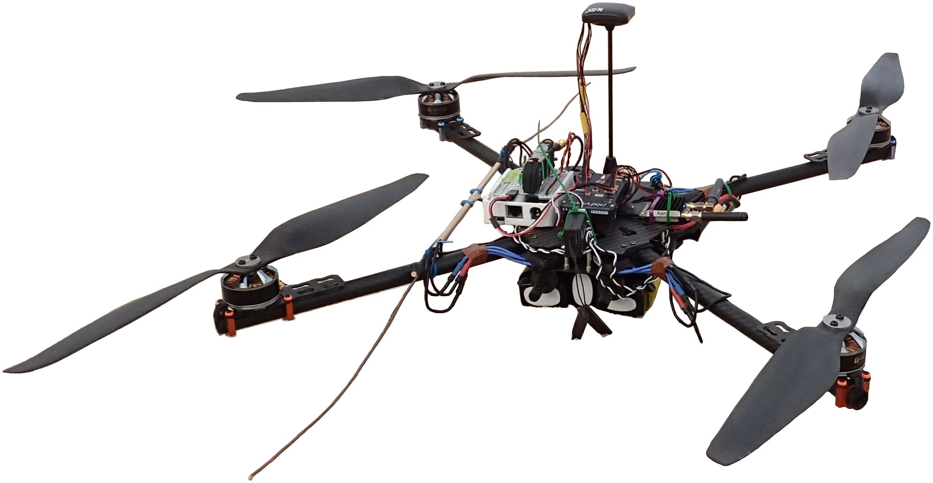
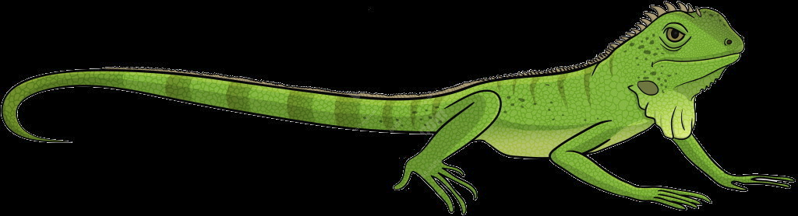
Solution
radio collar tracking via an autonomous drone!
Drone flies a search grid over a candidate area while recording a large swath of radio spectrum using a software defined radio (SDR)
Use DSP to extract the frequencies that the radio collars are transmitting on and a statistical model to determine where they are located

Slide 4
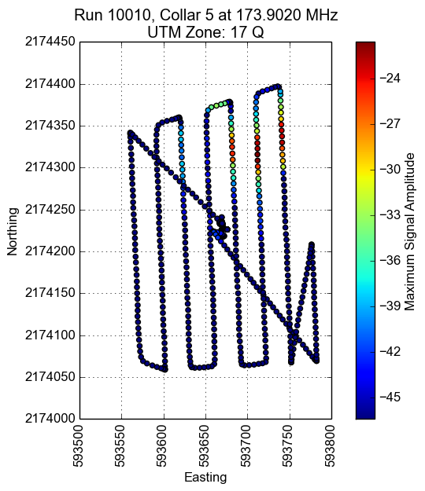
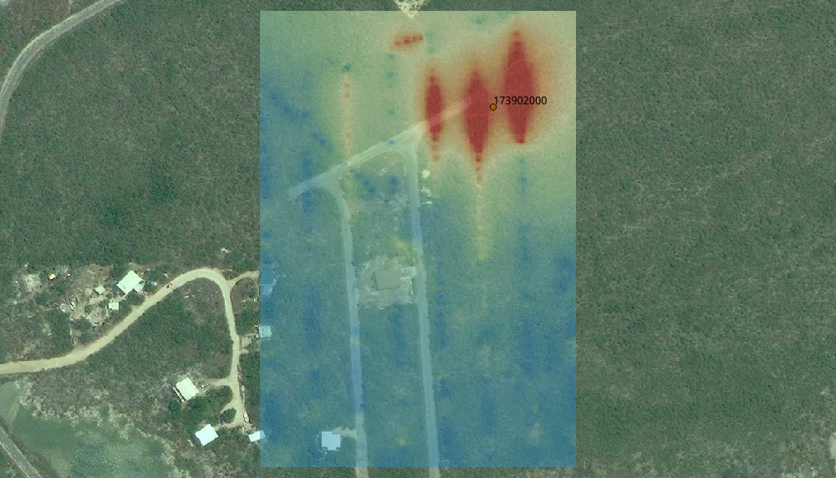
Cayman Islands (2016): Iguanas
Figure 1: Drone Flight Path
Figure 2: High Signal Amplitude Visualization

Slide 5
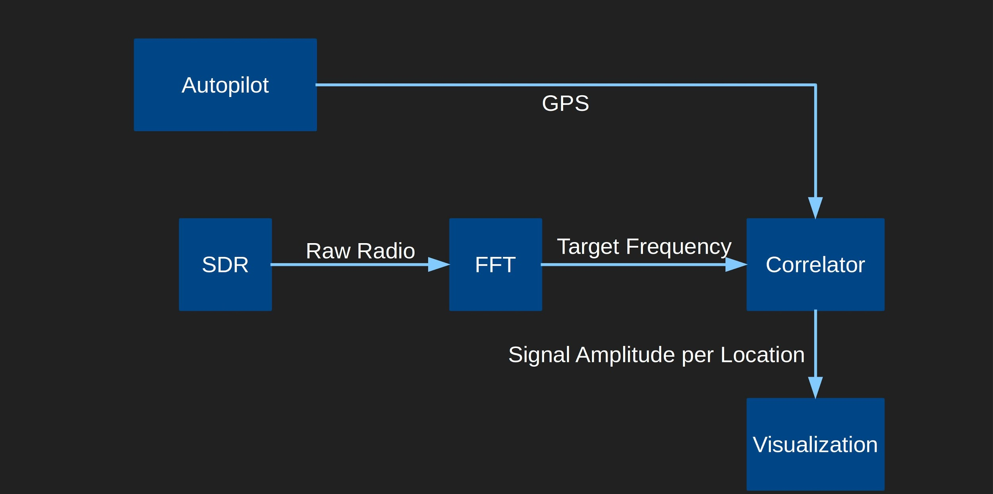
Data Analysis Flowchart
Notes:
FFT: Fast Fourier Transform Algorithm to convert from space/time to frequency domain and vice versa

Slide 6
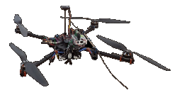
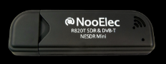
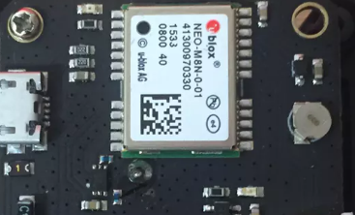
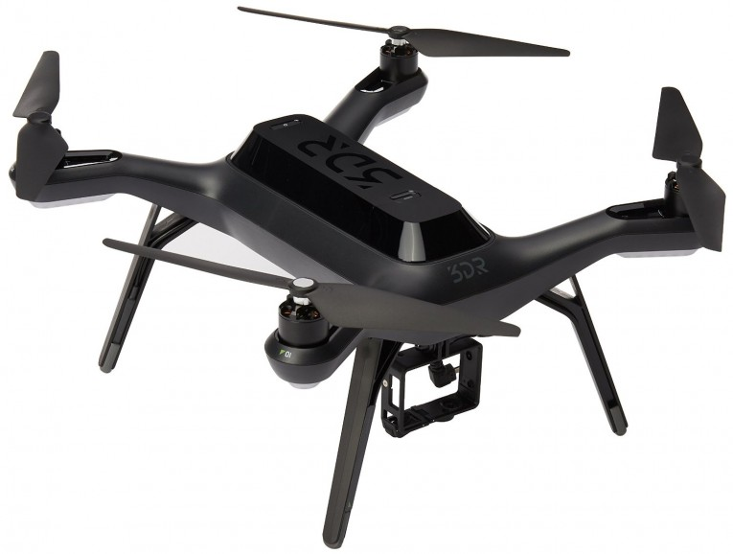
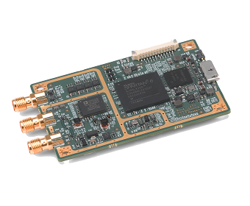
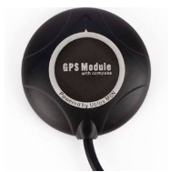
Hardware Modifications
Tarot Ironman 650
3DR Built-in GPS
3DR Solo
NI USRP B200-mini-i (SDR)
Ublox 8 Series
NooElec USB SDR
OLD
NEW
Notes:
Sam: I realized I made a mistake on the GPS modification. The Pixhawk doesn’t have a built in GPS as far as I know. When Nathan said switching from “autopilot (old)”, what exactly was he referring to? I.e. what is the model of GPS used before?

Slide 7



New Drone UI for Arming
Typically hardware start/stop switch used
Inconvenient for new 3DR Solo Quadcopter
Ideal Solution: Create WiFi based web interface to start/stop the drone

Slide 8
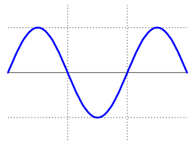

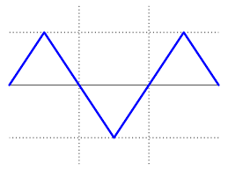
Radio Collar Emulator
Using USRP, produce imitation of radio collar signal
Switch different signals to see which one is detected the best.

Slide 9
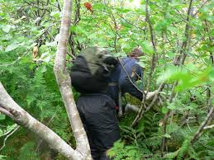

Don’t Bushwhack, Get a Drone
Bushwacking is no fun ;(
Drones are fun and avoid rough terrain!

